Slide 1

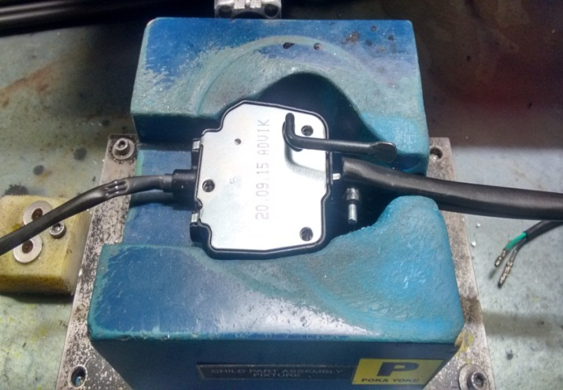
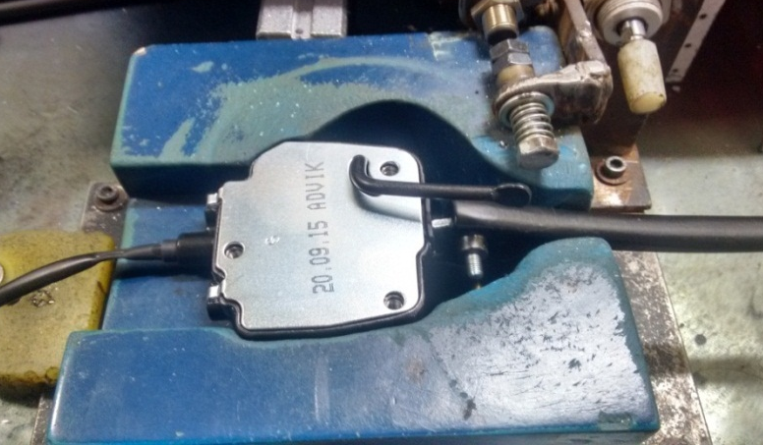
ADVIK(P12)
TPM CIRCLE NO :-
ACTIVITY
KK
QM
PM
JH
SHE
OT
DM
E&T
KAIZEN IDEA SHEET
TPM CIRCLE NAME :
LOSS NO. / STEP
CELL :- ASSEMBLY
DEPT :-
RESULT AREA
P
Q
DEF :- A
C
D
S
M
CELL NAME:- CBS LINES.
MACHINE / STAGE :- CHILD PART ASSLY & CONTI CHECK
OPERATION :- CHILD PART ASSEMBLY
KAIZEN THEME :- ARM COMP WELDING STRENGTH INSPECTION.
IDEA :- ONLINE CHECKING PROVISION AT DEAD ROTATION POSITION OF ARM COMP.
COUNTERMEASURE::- PNUEMATIC CYLINDER AND CENSOR PROVIDED. PART RELEASE FROM FIXTURE AFTER CENSING THE ARM COMP LEVER.
BENCHMARK
1No
WIDELY/DEEPLY:-
TARGET
0 No.
PROBLEM / PRESENT STATUS :-
KAIZEN START
12.09.2015
KAIZEN FINISH
16.09.2015
TEAM MEMBERS :-
AJAY KUMAR,RISHAL SINGH
BENEFITS :-
Online checking started.
Customer Delight.
Prevent the customer complaint.
KAIZEN SUSTENANCE
BEFORE
AFTER
WHAT TO DO – Updation in Poka-yoke sheet.
HOW TO DO: Checking the dead position of rotation in BRKT assy L brake.
FREQUENCY : 100%
WHY - WHY ANALYSIS :-
Why 1 – ARM COMP WELDING BROKEN.
Why 2 –PART SKIPPED TO CUSTOMER WITHOUT INSPECTION.
Why 3 –NO PROPER PROVISION FOR ONLINE CHECK.
RESULT :-
COST INCURRED FOR MAKING KAIZEN
MATERIAL COST
IN RS
LABOUR COST
IN RS
TOTAL COST
IN RS
7000
0
21000
ROOT CAUSE. NO PROVISION FOR ONLINE CHECKING.
SCOPE & PLAN FOR SELF PLANT HORIZONTAL DEPLOYMENT
SR.
NO.
CELL
TARGET
RESPONSIBILITY
STATUS
SCOPE & PLAN FOR OTHER PLANT HORIZONTAL DEPLOYMENT
REGISTRATION NO&DATE:- 17.09.2015:
SR.
NO.
CELL
TARGET
RESPONSIBILITY
STATUS
REGISTERED BY :- HR
1.
CBS LINE
(P12,P14,P18)
10.10.2015
RISHAL-P12
P12-IOK
MANAGER’S SIGN :- P.BHAYANA

